Slide 1
Math 10 Plus
Welcome Students!!!
Ms. Lilian Albarico

Slide 2
MEASUREMENT
UNIT 1

Slide 3
Chapter Contents
1 - Linear Measurement
2 - Trigonometry

Slide 4
Students will be expected to:
1) solve problems that involve linear measurement, using SI and imperial units of measure, estimation strategies, and measurement strategies.
2) apply proportional reasoning to problems that involve conversions between SI and imperial units of measure.
3) solve problems, using SI and imperial units, that involve the surface area and volume of 3-D objects, including right cones, right cylinders, right prisms, right pyramids, and spheres.
4) develop and apply the primary trigonometric ratios (sine, cosine, tangent) to solve problems that involve right triangles.

Slide 5
In this section, students are expected to:
Provide referents for linear measurements, including millimetre, centimetre, metre, kilometre, inch, foot, yard, and mile, and explain the choices.
Compare SI and imperial units, using referents.
Estimate a linear measure, using a referent, and explain the process used.
Justify the choice of units used for determining a measurement in a problem-solving context.
Solve problems that involve linear measure, using instruments such as rulers, calipers, or tape measures.
Describe and explain a personal strategy used to determine a linear measurement (e.g., circumference of a bottle, length of a curve, and perimeter of the base of an irregular 3-D object).

Slide 6
1.1 Imperial Measures of Length
Key Terms
SI System of Measures
Imperial Units
Referent
Unit Analysis

Slide 7
1.1 Imperial Measures of Length
Vocabulary
Inch
Yard
Foot

Slide 8
International System of Units

Slide 9
International
System of Units and
Prefixes

Slide 10
International System of Units, officially called the Système International d'Unités and abbreviated to SI, is based on the metric system. It is the primary system of measurement used throughout the world and in science.
This system is convenient and logical. In the SI system, the basic unit of length is the metre. Other linear units of SI measurement, both larger and smaller than the metre, use prefixes that indicate powers of 10 (1 kilometre = 103 metres; 1 millimere = 10–3 metres).

Slide 11
Base SI Units
Quantity | Unit | Symbol
Length | meter | m
Mass | kilogram | kg
Temperature | kelvin | K
Time | second | s
Amount of Substance | mole | mol
Luminous Intensity | candela | cd
Electric Current | ampere | a

Slide 12
Derived SI Units (examples)
Quantity | unit | Symbol
Volume | cubic meter | m³
Density | kilograms per cubic meter | kg/m³
Speed | meter per second | m/s
Newton | kg m/ s² | N
Energy | Joule (kg m²/s²) | J
Pressure | Pascal (kg/(ms²) | Pa

Slide 13
SI Unit Prefixes
Name | Symbol
giga- | G | 10⁹
mega- | M | 10⁶
kilo- | k | 10³
deci- | d | 10⁻¹
centi- | c | 10⁻²
milli- | m | 10⁻³
micro- | μ | 10⁻⁶
nano- | n | 10⁻⁹
pico- | p | 10⁻¹²

Slide 14
SI Unit Prefixes for Length
Name | Symbol
gigameter | Gm | 10⁹
megameter | Mm | 10⁶
kilometer | km | 10³
decimeter | dm | 10⁻¹
centimeter | cm | 10⁻²
millimeter | mm | 10⁻³
micrometer | μm | 10⁻⁶
nanometer | nm | 10⁻⁹
picometer | pm | 10⁻¹²

Slide 15
Imperial Measures of Length

Slide 16
IMPERIAL SYSTEM
EXAMPLES:
distance in miles
height in feet and inches
weight in pounds
capacity in gallons.

Slide 17
REFERENT
A referent is an object that can be used to help estimate a measurement. From the earliest introduction to metric units, students have had experience relating non-standard and standard units of measurement. They have used referents to estimate the length of an object in centimetres, metres, and millimetres.

Slide 18
Opening Activity
Find a partner.
Do Activity on page 5.

Slide 19
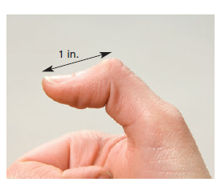
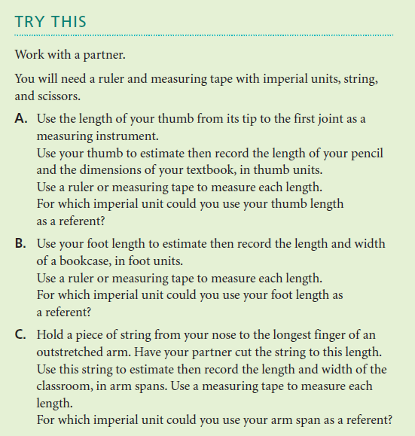
Opening Activity

Slide 20
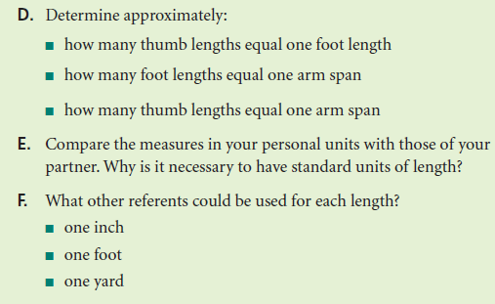

Opening Activity

Slide 21
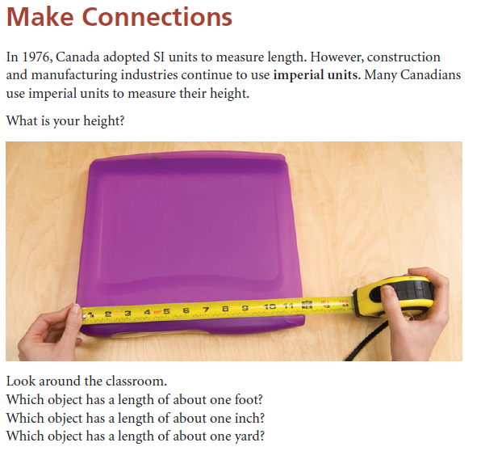
1.1 Imperial Measures of Length

Slide 22

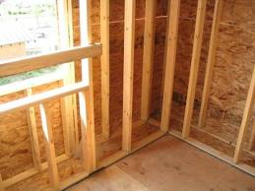
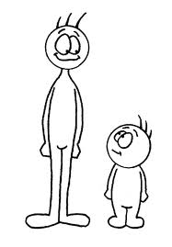
Where Will You See Imperial Units Used?
Real Estate: House floor plans are still calculated in sq. feet, not sq. metres.
Construction: Wood lengths (ie. a “two-by-four” is a piece of wood that is 2 inches thick and 4 inches wide)
Height: How many of us know our height in feet and inches (ie. 5’ 3”) versus centimetres?

Slide 23
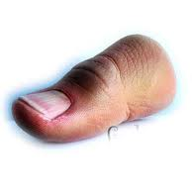
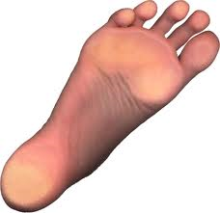

Approximating Imperial Units
Imperial units can be related to the human body. In fact this was how people originally measured objects.
The tip of your thumb to the first joint is approx.
1 inch (or 1”).
Your foot length is approx. 1 foot (or 1’).
Your arm span from is approx. 1 yard (or 1 yd).

Slide 24
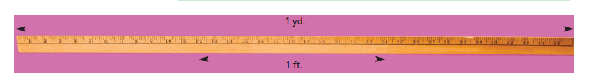
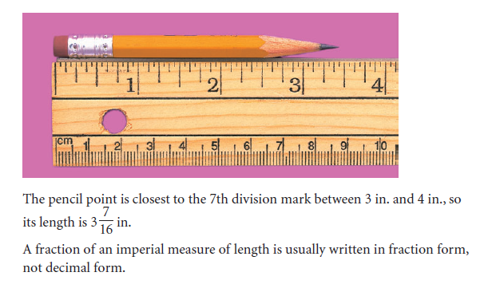
1.1 Imperial Measures of Length

Slide 25
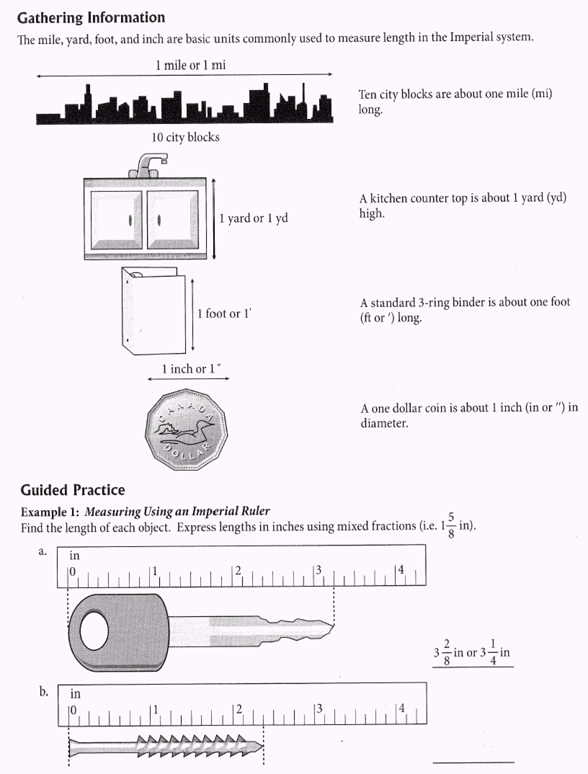
Approximating Imperial Units

Slide 26
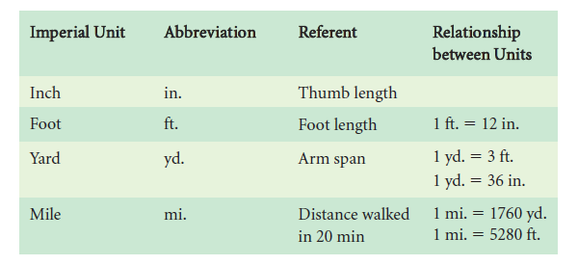
1.1 Imperial Measures of Length

Slide 27
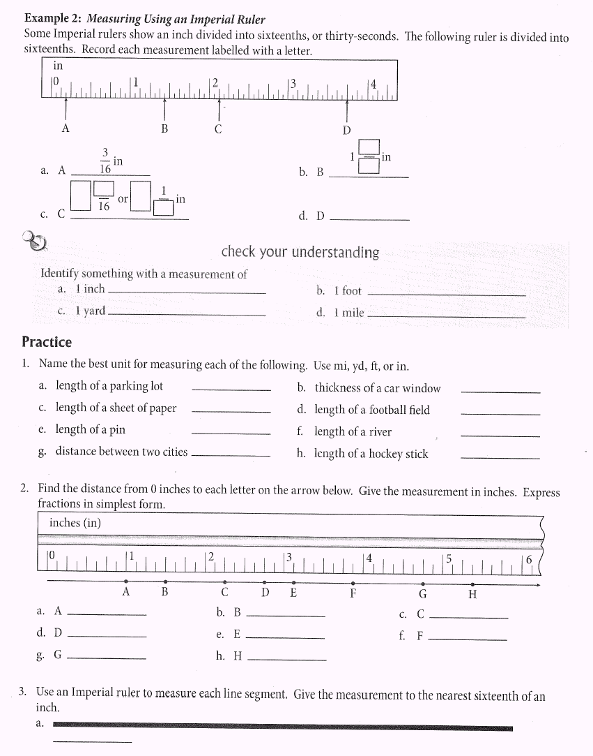
What Imperial Unit Should You Choose?
Name the best unit for each of the following. Use inches, feet, yards, or miles.
yd
in
in
yd
in
mi
mi
in

Slide 28
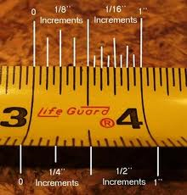
Reading an Imperial Measuring Tape or Ruler
Use fractional
increments, not decimals
The smallest unit is
1
16
Let’s try some examples…

Slide 29
Guided Practice
Fill in each measurement in inches and fractions of an inch. If you can reduce your fraction into ⅛, ¼, or ½, do so!

Slide 30
Converting Between Imperial Units
Use the following table (p. 6 in your textbook).
You will always be given the conversion factor on a test! (Not expected to memorize!)
Imperial Unit | Abbreviation | Conversion
Inch | in. or (“)
Foot | ft. or (‘) | 1 ft = 12 in.
Yard | yd. | 1 yd. = 3 ft. 1 yd = 36 in.
Mile | mi. | 1 mi. = 1760 yd. 1 mi. = 5280 ft.

Slide 31
To Convert Between Imperial Measurements…
Question: Convert 4 ft to in.
1. Set Up a Ratio
Start with what you know.
Fill in what you are looking for.
2. Cross Multiply and Divide

Slide 32
To Convert Between Imperial Measurements…
Question: Convert 90 ft to yd.
1. Set Up a Ratio
Start with what you know.
Fill in what you are looking for.
x = 90 ft
2. Cross Multiply and Divide
1(90) = 3(x)
x = 90
3
x = 30 yd.

Slide 33
To Convert Between Imperial Measurements…
Question: Convert 4 yd, 2ft to feet.
1. Set Up a Ratio
Start with what you know.
Fill in what you are looking for.
2. Cross Multiply and Divide

Slide 34
Problem Solving Involving Unit Conversion
Question: Ben buys baseboard for a bedroom. The perimeter of the room is 37 ft.
a)What length is needed in yards and feet?
1. Set Up a Ratio
Start with what you know.
Fill in what you are looking for.
x = 37 ft
2. Cross Multiply and Divide
1(37) = 3(x)
x = 37 = 12 1 yd. = 12 yd. 1 ft.
3 3

Slide 35
Problem Solving Involving Unit Conversion cont…
b) Baseboards are sold at $5.99/yd. What is the cost of materials before taxes?
He needed 12 yd. 1 ft. from part a)
He will have to buy 13 yards of baseboards as 12 will leave him short
Cost = $5.99 x 13 = $77.87

Slide 36
Two Unit Conversions
Some problems in your homework will require you to do two unit conversions.
  Ie. 70 miles is how many inches?
  You would have to first convert miles into feet, then feet into inches.
NOTE: ALL WORK MUST BE SHOWN AT ALL TIMES! I know there are many apps and websites that can do conversions for us. But you must be able to do these the paper and pencil way too.

Slide 37
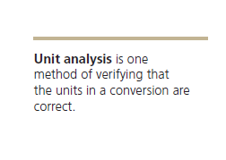
1.1 Imperial Measures of Length

Slide 38
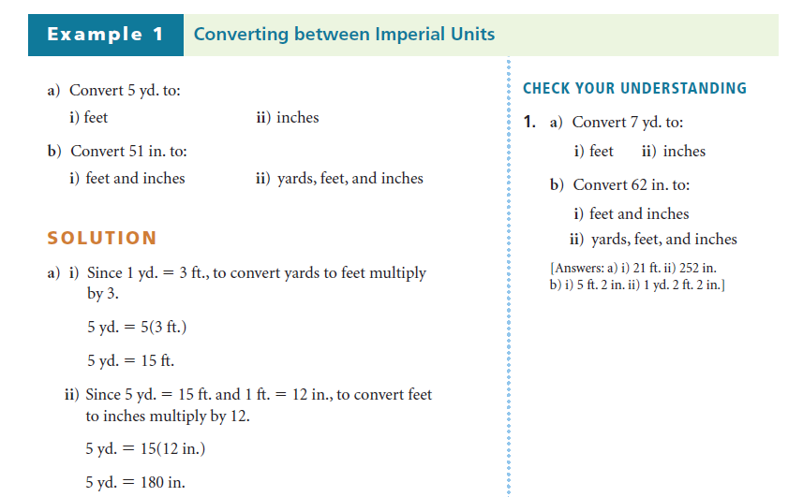
1.1 Imperial Measures of Length

Slide 39
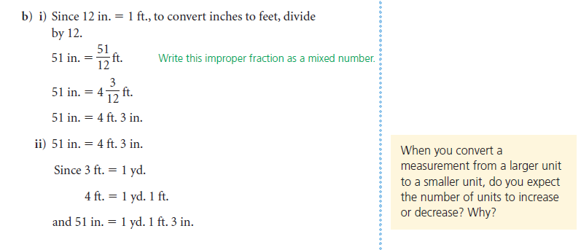
1.1 Imperial Measures of Length

Slide 40
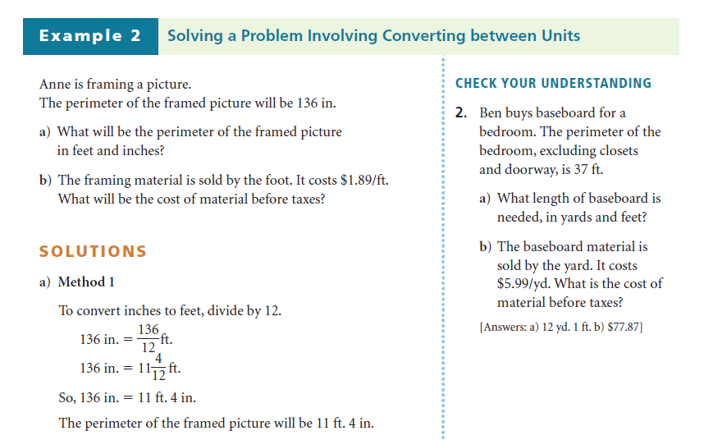
1.1 Imperial Measures of Length

Slide 41
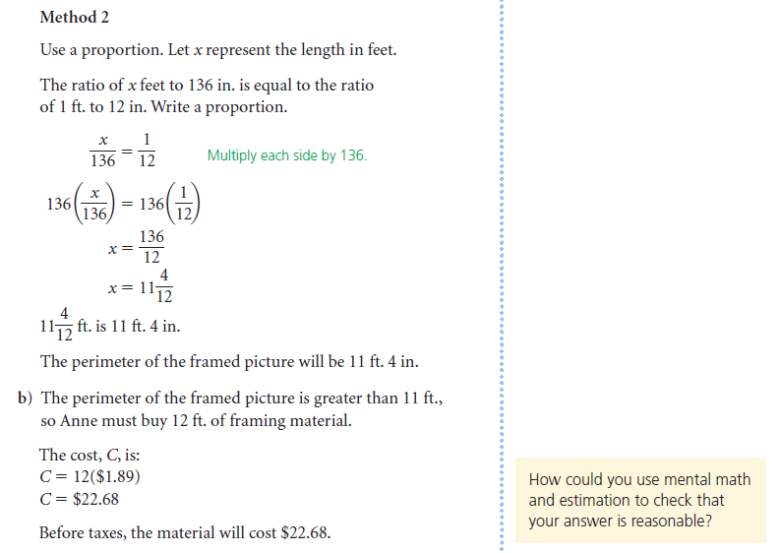
1.1 Imperial Measures of Length

Slide 42
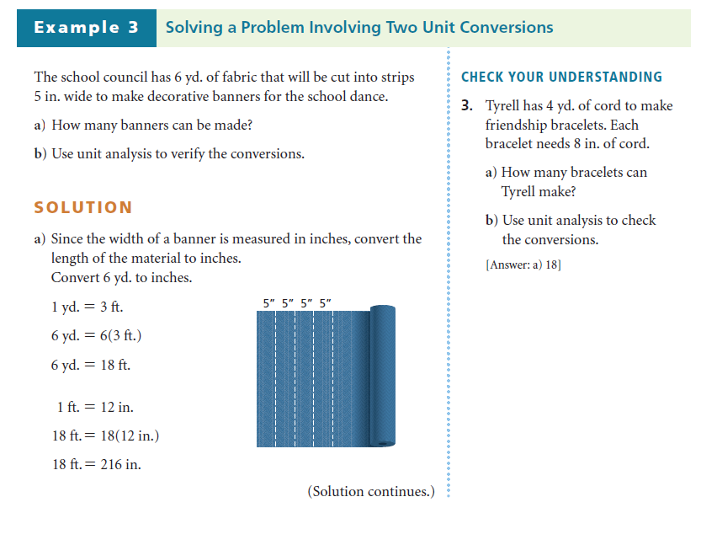
1.1 Imperial Measures of Length

Slide 43
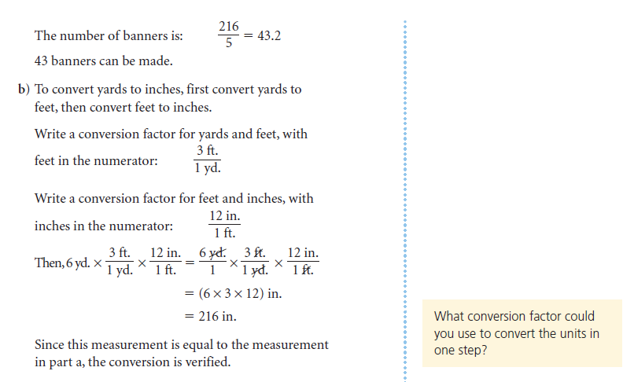
1.1 Imperial Measures of Length

Slide 44
1.1 Imperial Measures of Length

Slide 45
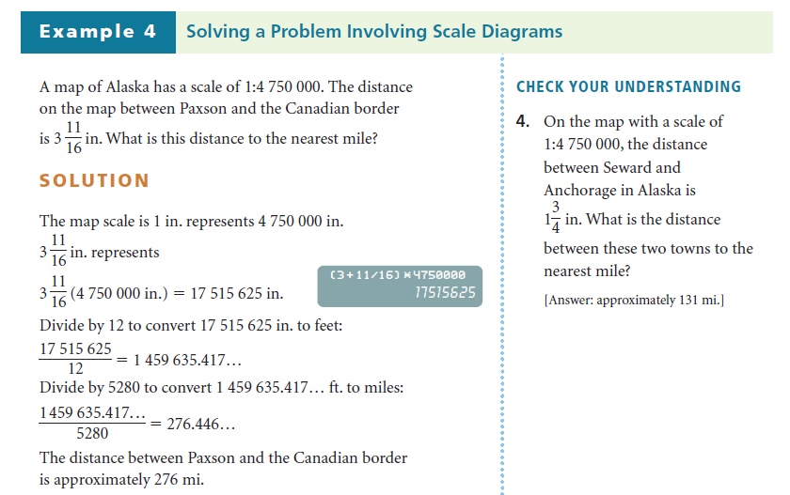
1.1 Imperial Measures of Length

Slide 46
To Do:
Class work
  Answer # 3, 5, & 7 on page 11.
Practice Exercise
  Answer # 8,10, 11, 13, 14, 15, 16, 18-22 pages 12-13.
Homework
  Answer your workbook on page

Slide 47
CALCULATOR COMMANDS
1) Turn ON your calculator. [2nd ON]
2) Press APPS [ Apps]
3) Scroll down till you find SciTools then press ENTER twice [↓ SciTools ENTER ENTER]
4) Select # 2 Unit Converter [↓ ENTER]
Or Press 2 then ENTER [ 2 ENTER]
5) Select #1 then press ENTER [ ENTER]
6) Choose the input unit and input the value then choose the output unit and press ENTER
Example : Convert 1 ft to inches.
[→ft ENTER 1 ENTER ← in ENTER]
Answer 1.2 E1 means 1.2 exponent of 1 = 12

Slide 48
1.1 Imperial Measures of Length

Slide 49
B. ACCURACY AND PRECISION

Slide 50
Accuracy - a measure of how close a measurement is to the true value of the quantity being measured.
The accuracy of a measurement indicates how
close the recorded measurement is to
the true value. It depends on the user’s
skill in using the tool. Other factors,
such as temperature and humidity,
can also influence the accuracy.

Slide 51
Accuracy deals with how close a number is to the actual or predicted value.
If the weatherperson predicts that the temperature on July 1st will be 30°C and it is actually 29°C, she is likely to be considered pretty accurate for that day.

Slide 52
Example: Accuracy
Who is more accurate when measuring a book that has a true length of 17.0cm?
Susan:
17.0cm, 16.0cm, 18.0cm, 15.0cm
Amy:
15.5cm, 15.0cm, 15.2cm, 15.3cm

Slide 53
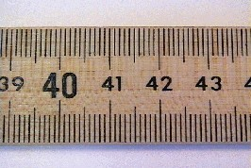
Centimeters and Millimeters

Slide 54
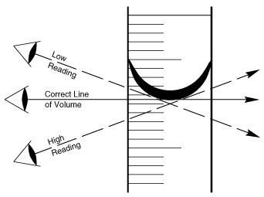
Graduated Cylinder Meniscus

Slide 55
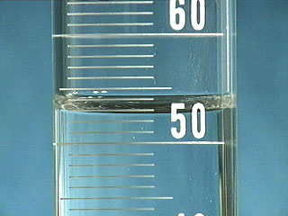

Slide 56
Precision – a measure of how close a series of measurements are to one another. A measure of how exact a measurement is.

Slide 57
Precision is directly linked to significant digits because the greater the number of significant digits, the more precise the measurement.
The precision of a measurement tool is the
smallest unit that can be measured
with confidence using the tool. It
depends on the fineness of the scale
on the tool.

Slide 58
Example: Precision
Who is more precise when measuring the same 17.0cm book?
Susan:
17.0cm, 16.0cm, 18.0cm, 15.0cm
Amy:
15.5cm, 15.0cm, 15.2cm, 15.3cm

Slide 59
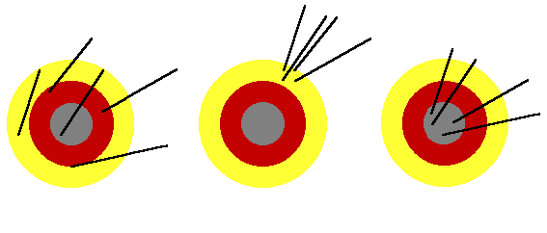
Example: Evaluate whether the following are precise, accurate or both.
Accurate
Not Precise
Not Accurate
Precise
Accurate
Precise

Slide 60
More About Metric System

Slide 61
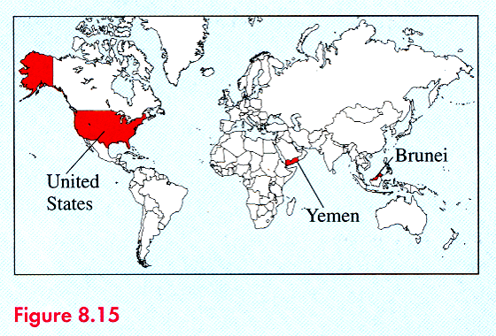
DID YOU KNOW
It’s a metric world!
The United States is the only western country not presently using the metric system as its primary system of measurement. The only other countries in the world not using metric system as their primary system of measurement are Yemen, Brunei, and a few small islands; see Fig. 8.15.

Slide 62
DID YOU KNOW
In 1906, there was a major effort to convert to the metric system in the United States, but it was opposed by big business and the attempt failed.
The Trade Act of 1988 and other legislation declare the metric system the preferred system of weights and measures of the U.S. trade and commerce, call for the federal government to adopt metric specifications, and mandate the Commerce Department to oversee the program. The conversion is currently under way; however, the metric system has not become the system of choice for most Americans’ daily use.

Slide 63
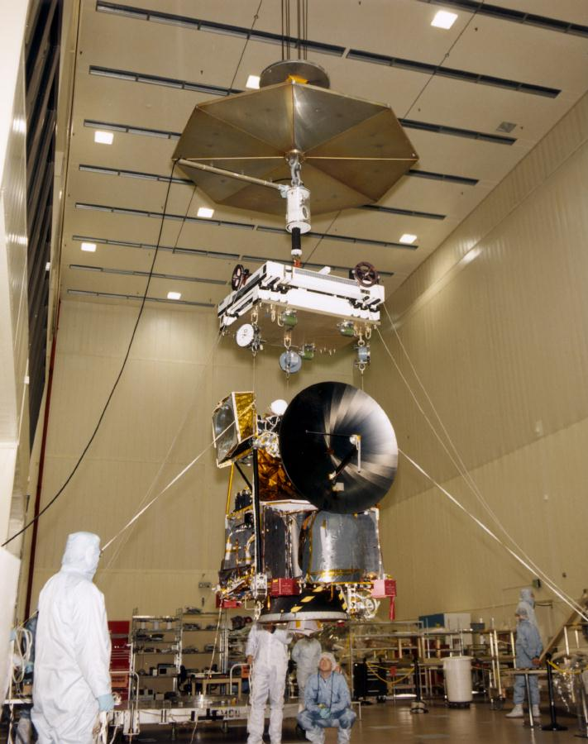
DID YOU KNOW
Lost in space!
In September 1999, the United States lost the Mars Climate Orbiter as it approached Mars. The loss of the $125 million spacecraft was due to scientists confusing English units and metric units.
Two spacecraft teams, one at NASA’s Jet Propulsion Lab (JPL) in Pasadena, CA, and the other at a Lockheed Martin facility in Colorado, where the spacecraft was built, were unknowingly exchanging some vital information in different units.
The missing Mars Climate Orbiter

Slide 64
DID YOU KNOW
Lost in space!
The spacecraft team in Colorado used English units of pounds of force to describe small forces needed to adjust the spacecraft’s orbit. The data was shipped via computer, without units, to the JPL, where the navigation team was expecting the to receive the data in metric measure.
The mix-up in units led to the JPL scientists giving the spacecraft’s computer wrong information, which threw the spacecraft off course. This in turn led to the spacecraft entering the Martian Atmosphere, where it burned up.
The missing Mars Climate Orbiter

Slide 65
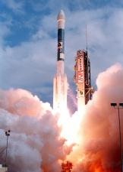
DID YOU KNOW
Lost in space
On Jan. 3, 1999, NASA launched the $165 million Mars Polar Lander. All radio contact was lost Dec. 3 as the spacecraft approached the red planet.
A NASA team that investigated the loss of the Mars Polar Lander concluded a rocket engine shut off prematurely (due to programming error) during landing, leaving the spacecraft to plummet about 130 feet to almost certain destruction on the Martian surface.

Slide 66
Length
American standard
1 mile = 1760 yards
= (5280 feet)
1 yard = 3 feet
1 foot = 12 inches
1 mil = ¹/_{1,000} inch
Metric standard
1 kilometer = 1000 meters
1 meter = 10 decimeters
1 decimeter = 10 centimeters
(∴ 1 meter = 100 centimeters)
1 centimeter = 10 millimeters
Conversion:
1 inch is defined to be exactly 2.54 cm in July, 1959.
(before this, the UK inch measures 2.53998 cm, while the US inch was 2.540005 cm)

Slide 67
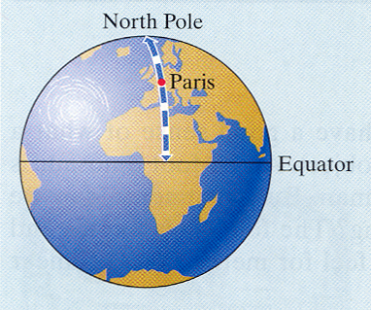
Historical Note
The kilometer was first defined by the French Academy of Science in 1791 as the romantic one ten-thousandth of the length of the meridian through Paris from the North pole to the equator.

Slide 68
Weight
American Standard
1 ton = 2000 pounds
1 pound = 16 ounces
Metric Standard
1 (metric) tonne = 1000 kilograms
1 kilogram = 1000 grams
1 gram = 1000 milligrams
Conversion:
1 pound = 0.453 592 37 kilograms
1 kilogram ≈ 2.2 pounds

Slide 69
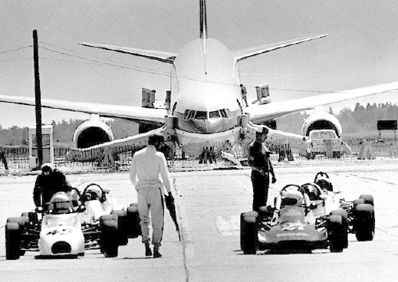
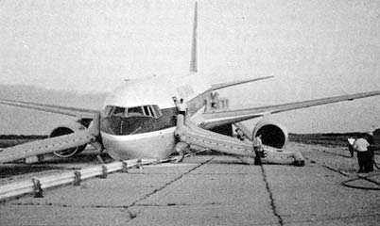
The Gimli Glider - a mixed up in units
On July 23, 1983 Air Canada Flight 143 (a brand new Boeing 767) ran out of fuel while en routing to Edmonton from Montreal at 26,000 feet.
Miraculously the caption was able to land the plane on an abandoned Royal Canadian Air Force Base at Gimli, where the runways were converted into two lane dragstrips for auto racing.
No one was killed.

Slide 70
The Gimli Glider - a mixed up in units
This mistake was caused by the ignorance of metric units. The new 767 uses liters and kg to compute fuel consumption while the crew and refuelers were only familiar with pounds and gallons.
They used 1.77lb/liter instead of 0.8kg/liter.
The fuel quantity information system was inoperative before the flight was started in Montreal.
Video clip

Slide 71
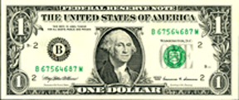
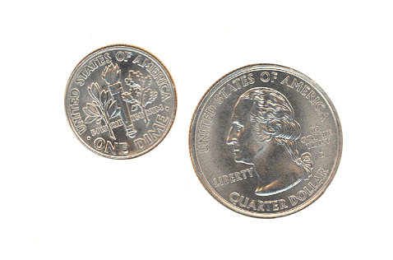
by the way …
The abbreviation for the pound, lb, comes from the Latin libra, meaning “scales”.
A dollar bill weighs about 1 gram,
a dime weighs about 2 grams,
and a quarter 5 grams.

Slide 72
Volume for Liquid
American Standard
1 gallon = 4 quarts
1 quart = 2 pints
1 pint = 16 fluid ounces
(also 1 pint = 2 cups
1 cup = 16 Tablespoons
1 TBS = 3 teaspoons )
Metric Standard
1 liter = 1000 milliliters
1 milliliter = 1 c.c.
Conversion:
1 gallon = 3.785 411 784 liters
≈ 3.8 liters
1 gallon = 231 cubic inches

Slide 73
Area
American Standard
1 square mile = 640 acres
1 acre = 43560 square feet
Historical Note
An acre is originally defined as the amount of land a pair of oxen could plow in a day.
F.Y.I.
A football field (including end zones) measures 57600 sq feet, hence it is equal to 1.322 acres, or approximately 1 and ½ acres.

Slide 74
Homework
Study for the short Quiz next meeting.

