Slide 1
SPHERES
Lesson 4

Slide 2
Students are expected to:
Solve a problem that involves surface area or volume, given a diagram of a composite
3-D object.

Slide 3
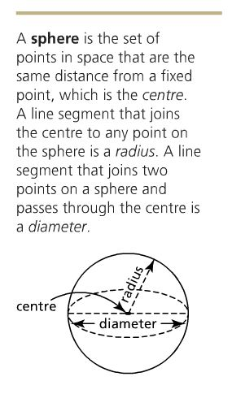
SPHERE

Slide 4
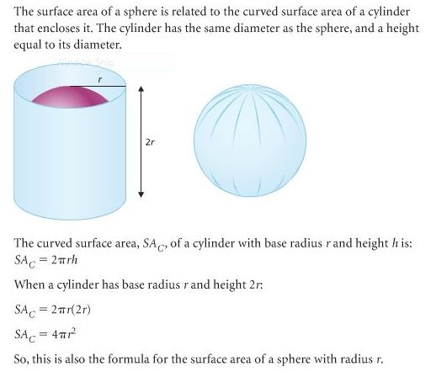

Slide 5
Example 1

Slide 6
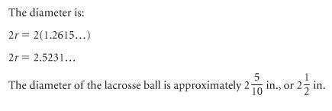
Example 2
Notes:
Interactive on the book…

Slide 7
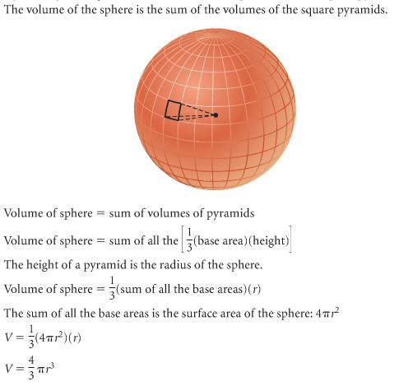
VOLUME OF A SPHERE

Slide 8
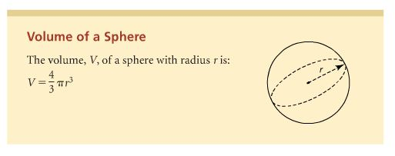
VOLUME OF A SPHERE

Slide 9
Class Exercise
Answer # 7-14 on page 51.
HOMEWORK
1) Copy Checkpoint 2 on page 53 ON YOUR NOTEBOOK.
2) Try to answer ASESS YOUR UNDERSTANDING on page 54.

