Slide 1
VOLUMES
Lesson 3

Slide 2
Students are expected to:
Sketch a diagram to represent a problem that involves surface area or volume.
Determine the volume of a right cone, right cylinder, right prism, right pyramid, or sphere, using an object or its labelled diagram.
Determine an unknown dimension of a right cone, right cylinder, right prism, right pyramid, or sphere, given the object’s surface area or volume and the remaining dimensions.
Solve a problem that involves surface area or volume, given a diagram of a composite 3-D object.
Describe the relationship between the volumes of right cones and right cylinders with the same base and height, and right pyramids and right prisms with the same base and height.

Slide 3
Topics
What is a Volume
Volumes of Cuboids
Volumes of Triangular Prism
Volumes of a Right Prism and a Right Pyramid
Volumes of a Right Cone and Right Cylinder

Slide 4
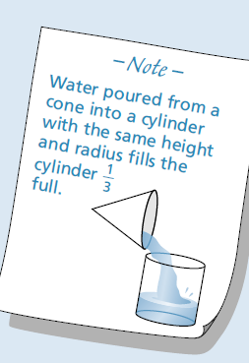
What Is Volume ?
The volume of a solid is the amount of space inside the solid.
Consider the cylinder below:
If we were to fill the cylinder with water the volume would be the amount of water the cylinder could hold:

Slide 5
Volume
is the amount of space occupied by any 3-dimensional object.
1cm
1cm
1cm
Volume = base area x height
= 1cm² x 1cm
= 1cm³

Slide 6
Measuring Volume
Volume is measured in cubic centimetres (also called centimetre cubed).
Here is a cubic centimetre
It is a cube which measures 1cm in all directions.
1cm
1cm
1cm
We will now see how to calculate the volume of various shapes.

Slide 7
1. Volumes Of Cuboids
Look at the cuboid below:
4cm
3cm
10cm
We must first calculate the area of the base of the cuboid:
The base is a rectangle measuring 10cm by 3cm:
10cm
3cm

Slide 8
10cm
3cm
Area of a rectangle = length x breadth
Area = 10 x 3
Area = 30cm²
We now know we can place 30 centimetre squares on the base of the cuboid. But we can also place 30 cubic centimetres on the base:
4cm
3cm
10cm

Slide 9
4cm
3cm
10cm
We have now got to find how many layers of 1cm cubes we can place in the cuboid:
We can fit in 4 layers.
Volume = 30 x 4
Volume = 120cm³
That means that we can place 120 of our cubes measuring a centimetre in all directions inside our cuboid.

Slide 10
4cm
3cm
10cm
We have found that the volume of the cuboid is given by:
Volume = 10 x 3 x 4 = 120cm³
This gives us our formula for the volume of a cuboid:
Volume = Length x Breadth x Height
V=LBH for short.

Slide 11
What Goes In The Box ?
Calculate the volumes of the cuboids below:
(1)
(2)
7cm
3.4cm
5 cm
3.4cm
14cm
490cm³
3.4cm
39.3cm³
(3)
3.2m
2.7m
76.9 m³
8.9 m

Slide 12
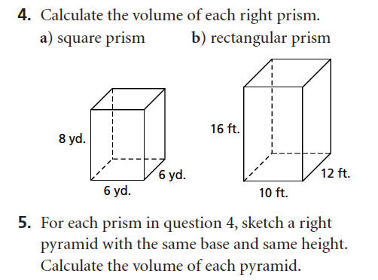
PRACTICE EXERCISE

Slide 13
2. The Volume Of A Triangular Prism
Consider the triangular prism below:
Volume = Cross Section x Height
What shape is the cross section ?
Triangle.
5cm
Calculate the area of the triangle:
A = ½ x base x height
A = 0.5 x 5 x 5
8cm
A = 12.5cm²
5cm
Calculate the volume:
Volume = Cross Section x Length
The formula for the volume of a triangular prism is :
V = ½ b h l
b= base h = height l = length
V = 12.5 x 8
V = 100 cm³

Slide 14
What Goes In The Box ?
Calculate the volume of the shapes below:
(1)
4m
5m
3m
(2)
30m³
8cm
12cm
288cm³
6cm

Slide 15
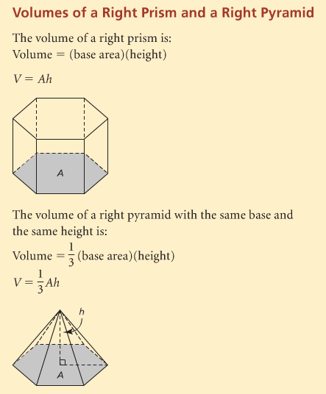
3. Volume Of A Right Prism and a Right Pyramid

Slide 16
Show Interactive Media

Slide 17
Refer to Textbook Example 1-2 on page #37-38.

Slide 18
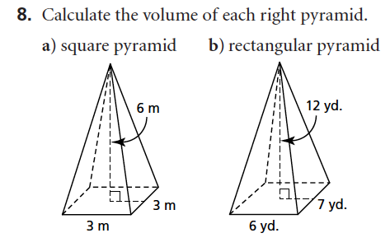
PRACTICE EXERCISE

Slide 19
4. Volumes Of A Right Prism and a Right Pyramid

Slide 20
A. The Volume Of A Cylinder
Consider the cylinder below:
It has a height of 6cm .
What is the size of the radius ?
2cm
6cm
Volume = cross section x height
What shape is the cross section?
Circle
Calculate the area of the circle:
A = ∏ r ²
4cm
A = 3.14 x 2 x 2
The formula for the volume of a cylinder is:
V = ∏ r ² h
r = radius h = height.
A = 12.56 cm²
Calculate the volume:
V = ∏ r ² x h
V = 12.56 x 6
V = 75.36 cm³

Slide 21
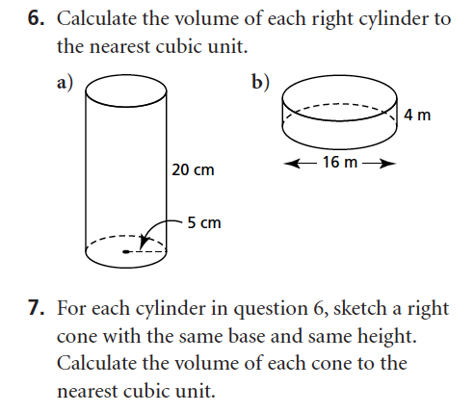
PRACTICE EXERCISE

Slide 22
B. Volume Of A Cone
Consider the cylinder and cone shown below:
D
D
The diameter (D) of the top of the cone and the cylinder are equal.
H
H
The height (H) of the cone and the cylinder are equal.
If you filled the cone with water and emptied it into the cylinder, how many times would you have to fill the cone to completely fill the cylinder to the top ?
3 times.
This shows that the cylinder has three times the volume of a cone with the same height and radius.

Slide 23
The experiment on the previous slide allows us to work out the formula for the volume of a cone:
The formula for the volume of a cylinder is :
V = ∏ r ² h
We have seen that the volume of a cylinder is three times more than that of a cone with the same diameter and height .
The formula for the volume of a cone is:
r
h
r = radius h = height

Slide 24
Calculate the volume of the cones below:
(1)
(2)
18m
6m
9m
13m

Slide 25
Refer to Textbook Example 3-4 on page #39-40.

Slide 26
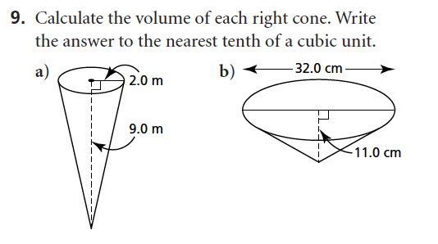
PRACTICE EXERCISE

Slide 27
Volumes of Composite Objects

Slide 28
More Complex Shapes
Calculate the volume of the shape below:
12m
Calculate the volume:
Volume = Cross sectional area x length.
V = 256 x 23
V = 5888m³
16m
A1
A2
23m
20m
Calculate the cross sectional area:
Area = A1 + A2
Area = (12 x 16) + ( ½ x (20 –12) x 16)
Area = 192 + 64
Area = 256m²

Slide 29
Example 2
Calculate the volume of the shape below:
A2
10cm
A1
Calculate the volume.
Volume = cross sectional area x Length
18cm
12cm
V = 176.52 x 18
Calculate the cross sectional area:
V = 3177.36cm³
Area = A1 + A2
Area = (12 x 10) + ( ½ x ∏ x 6 x 6 )
Area = 120 +56.52
Area = 176.52cm²

Slide 30
What Goes In The Box?
11m
(1)
4466m³
14m
22m
(2)
18m
17cm
19156.2cm³
32cm
23cm

Slide 31
HOMEWORK
-# 13-22 on page #42-44

Slide 32
Summary Of Volume Formulas
r
h
h
b
l
V = l b h
V = ∏ r ² h
r
h
h
l
b
V = ½ b h l

Slide 33
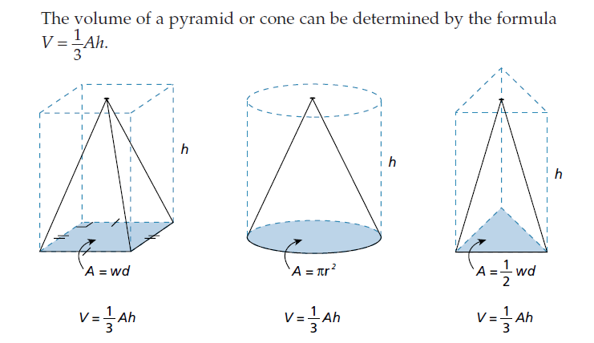

Slide 34
