Slide 1
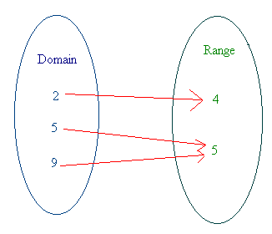
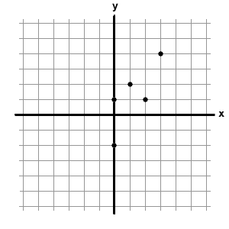
RELATIONS AND FUNCTIONS
UNIT 3

Slide 2
RELATIONS AND FUNCTIONS
5.1 – Representing Relations
5.2 – Properties of Functions
5.3 – Interpreting and Sketching Graphs
5.4 – Graphing Data
5.5 – Graphs of Relations and Functions
5.6 – Properties of Linear Equations
5.7 – Interpreting Graphs of Linear Functions

Slide 3
Students are expected to:
Graph, with or without technology, a set of data, and determine the restrictions on the domain and range.
Explain why data points should or should not be connected on the graph for a situation.
Describe a possible situation for a given graph.
Sketch a possible graph for a given situation.
Determine, and express in a variety of ways, the domain and range of a graph, a set of ordered pairs, or a table of values.

Slide 4
5.1 REPRESENTING Relations

Slide 5
Key Terms
arrow diagram
relation
function
set
element

Slide 6
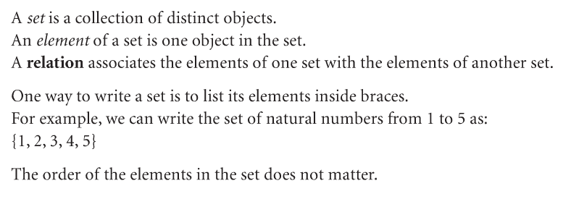
Introduction

Slide 7
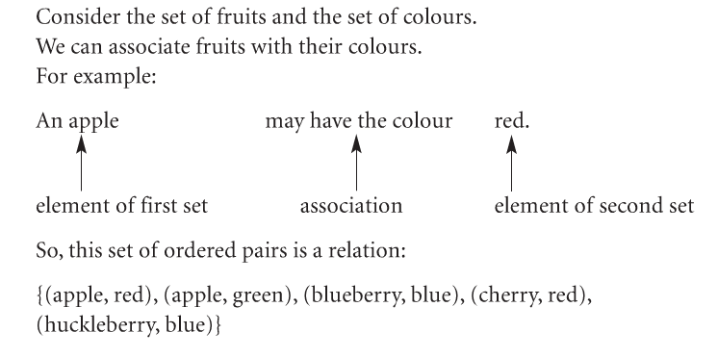
Example:

Slide 8
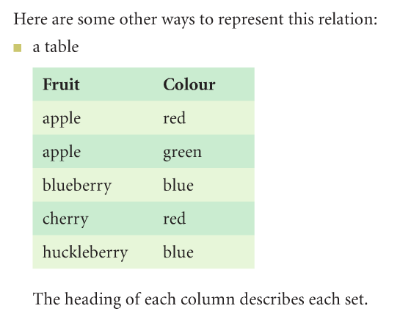

Slide 10
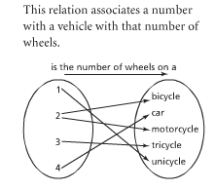
A Relation is a rule that produces one or more
output numbers for every valid input number
(x and y values may be repeated).
This represents only a relation
because the input value or
x-value of 2 was used twice.
Therefore this relation is not a
Function.
All functions are relations but not all relations are functions!

Slide 11
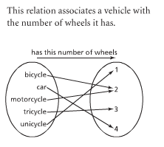
Function
X values are always located
on the right and y values are
on the left.
They can be represented by
words, symbols or numbers.
This represents a function as every input value (x) has only been used once.

Slide 12
Relations and functions can be shown many
different ways.
Are these relations or functions?
Function
&
Relation
x
y
1
2
3
4
5
6
7
x y
5
6
7
6
(1, 5), (2, 6), (3, 7), (4, 6)

Slide 13
Are these relations or functions?
Not a Function but a
Relation
x
y
1
2
5
6
7
x y
5
6
1 7
1 6

Slide 14
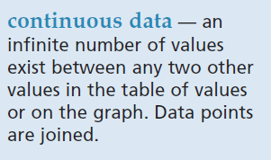
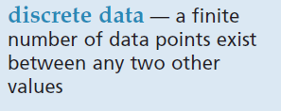
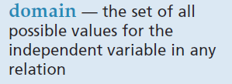
Key Terms

Slide 15
How about some more definitions? The domain is the
set of 1st coordinates of the ordered pairs.
The range is the
set of 2nd coordinates of the ordered pairs.
A relation is a
set of ordered pairs.

Slide 16
Given the relation {(3,2), (1,6), (-2,0)}, find the domain and range.
Domain = {3, 1, -2}
Range = {2, 6, 0}

Slide 17
What is the domain of the relation {(2,1), (4,2), (3,3), (4,1)}
{2, 3, 4, 4}
{1, 2, 3, 1}
{2, 3, 4}
{1, 2, 3}
{1, 2, 3, 4}
Answer Now

Slide 18
What is the range of the relation {(2,1), (4,2), (3,3), (4,1)}
{2, 3, 4, 4}
{1, 2, 3, 1}
{2, 3, 4}
{1, 2, 3}
{1, 2, 3, 4}
Answer Now

Slide 19
The relation {(2,1), (-1,3), (0,4)} can be shown by
x
y
1) a table.
2) a mapping.
3) a graph.
2
-1
0
1
3
4
2
-1
0
1
3
4

Slide 20
Given the following table, show the relation, domain, range, and mapping. x -1 0 4 7 y 3 6 -1 3
Relation = {(-1,3), (0,6), (4,-1), (7,3)}
Domain = {-1, 0, 4, 7}
Range = {3, 6, -1, 3}

Slide 21
Mapping x -1 0 4 7 y 3 6 -1 3
-1
0
4
7
3
6
-1
You do not need to write 3 twice in the range!

Slide 22
Example 1- 3
Refer to the textbook. Page 259-262

Slide 23
Class Exercises
Answer # 3-6 on pages 262.

Slide 24
PROPERTIES OF FUNCTIONS

Slide 25
Domain: a set of first elements in a relation
(all of the x values). These are also called
the independent variable.
Range: The second elements in a relation
(all of the y values). These are also called
the dependent variable.

Slide 26
How would you use your calculator to solve 5²?
Input
Output
5
x²
25
The number you entered is the input number (or x-value on a graph).
The result is the output number (or y-value on a graph).
What is the calculator commands?

Slide 27
A function is a relation that gives a single
output number for every valid input number
(x values cannot be repeated).
A relation is a rule that produces one or more
output numbers for every valid input number
(x and y values may be repeated).
There are many ways to represent relations:
Graph
Equation
Table of values
A set of ordered pairs
Mapping
These are all ways of showing a relationship between two variables.

Slide 28
Are these relations or functions?
x
y
Not a function
But a relation
1
2
3
5
6
8
11
x y
5
6
11
8

Slide 29
In words:
Double the number and add 3
As an equation:
y = 2x + 3
These all represent the SAME function!
As a table of values:
x y
-2 -1
-1 1
0 3
1 5
As a set of ordered pairs:
(-2, -1) (-1,1) (0,3) (1, 5) (2, 7) (3, 9)

Slide 30
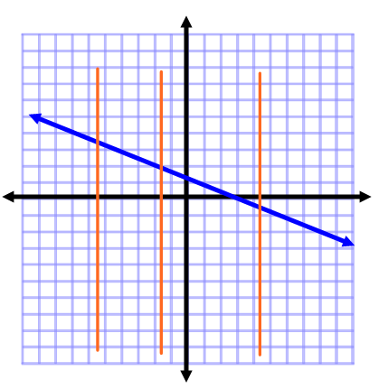
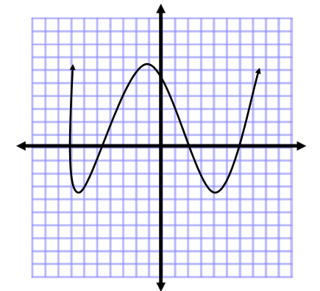
Vertical Line Test: if every vertical line you can draw goes through only 1 point then the relation is a function.

Slide 31
Check Your Understanding

Slide 32
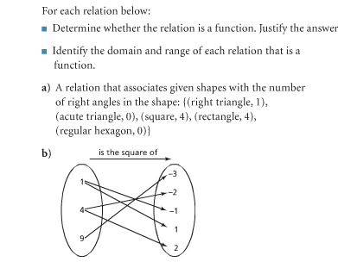
a)
b)

Slide 33
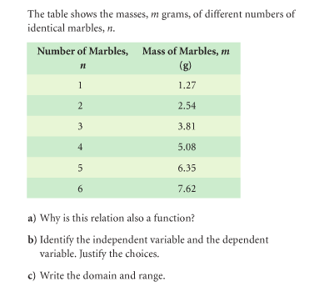
a)
b)
c)

Slide 34
Class work:
Answer CYU # 4-9 on pages 270-271.

Slide 35
Homework
Answer # 7-10 on page 263.
Answer # 14-16, 19-23 on pages 272-273.

Slide 36
References
teachers.henrico.k12.va.us/
sms8thmath.weebly.com/

