Slide 1
ROOTS AND POWERS
Chapter 4

Slide 2
Students are expected to:
Develop algebraic reasoning and number sense.
Demonstrate an understanding of powers with integral and rational exponents.

Slide 3
real numbers

Slide 4
REAL NUMBER - any number that is a rational number or an irrational number; a member of the set of numbers that have a decimal representation

Slide 6
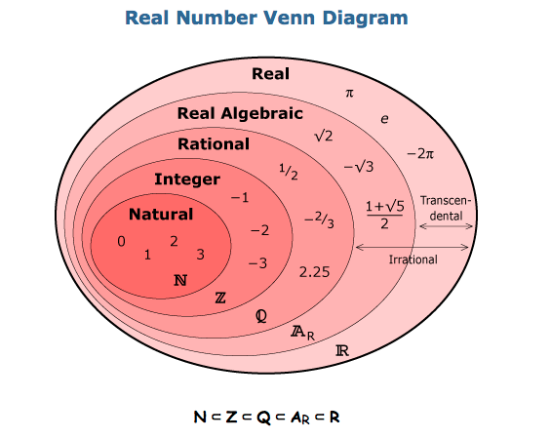
REAL NUMBERS

Slide 7
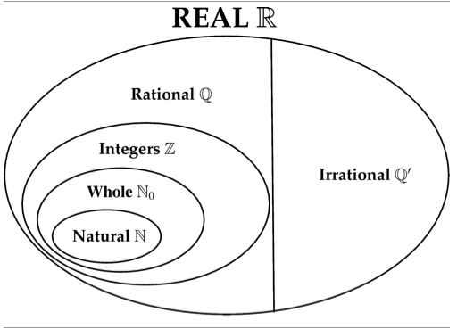

Slide 8
REAL NUMBERS

Slide 9
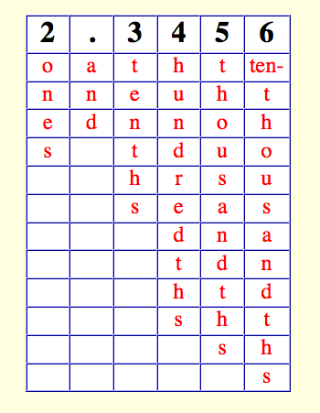
Radicals that are square roots of perfect squares, cube roots of perfect cubes,
and so on are rational numbers.
Rational numbers have decimal
representations that either terminate or repeat.

Slide 16
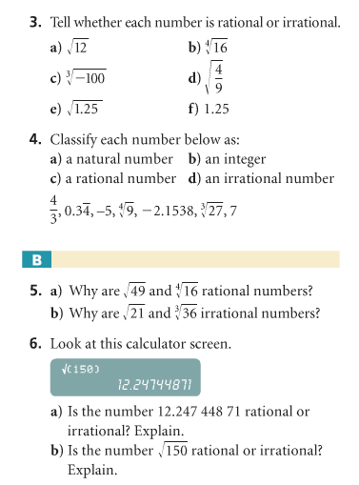
PRACTICE EXERCISE

Slide 17
HOMEWORK
Answer Check Your Understanding # 7-15, 18, 21-23 on pages 211-212.

Slide 18
references
http://www.regentsprep.org/regents/math/algebra/aop1/lrat.htm
http://cnx.org/content/m38348/latest/
http://thinkzone.wlonk.com/Numbers/NumberSets.htm

