Slide 1
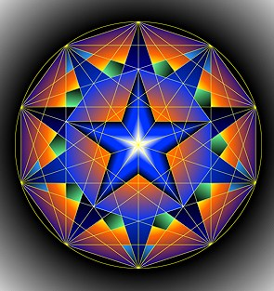
GEOMETRY
Math 10

Slide 2
Students are expected to:
Sketch a diagram to represent a problem that involves surface area or volume.
Determine the surface area of a right cone, right cylinder, right prism, right pyramid, or sphere, using an object or its labelled diagram.
Determine the volume of a right cone, right cylinder, right prism, right pyramid, or sphere, using an object or its labelled diagram.
Determine an unknown dimension of a right cone, right cylinder, right prism, right pyramid, or sphere, given the object’s surface area or volume and the remaining dimensions.
Solve a problem that involves surface area or volume, given a diagram of a composite 3-D object.
Describe the relationship between the volumes of right cones and right cylinders with the same base and height, and right pyramids and right prisms with the same base and height.

Slide 3
What is Geometry?
Geometry is the study of shapes.
History
They studied Geometry in Ancient Mesopotamia & Ancient Egypt.
Geometry is important in the art and construction fields.

Slide 4
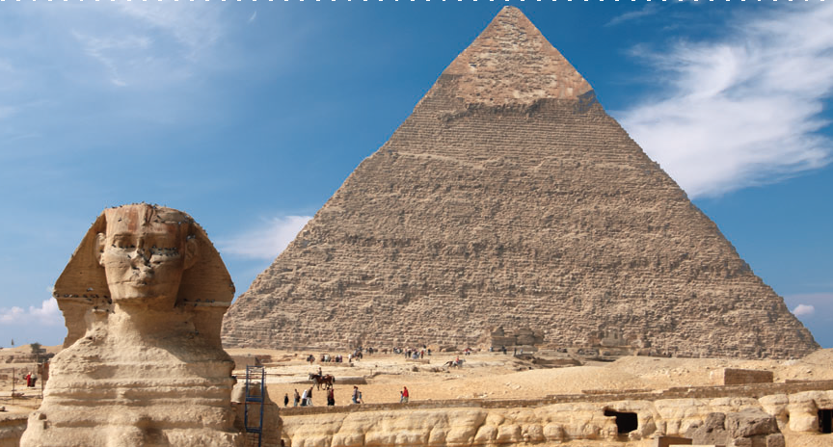
The ancient pyramids at Giza, Egypt, were built about 4500 years ago.
The pyramid above has a square base with a side length of 755 feet. The original height of the pyramid was 481 feet. Archeologists believe that the pyramid was once covered with a white limestone casing.

Slide 5
REVIEW

Slide 6
TYPES OF GEOMETRY
PLANE GEOMETRY
SOLID GEOMETRY

Slide 7
PLANE GEOMETRY

Slide 8
BASIC 2D Shapes
Vocabulary Review
equilateral, isosceles, right
Know the different types of triangles
rhombus, square, rectangle,
parallelogram, trapezoid
Know the different types of quadrilaterals
Notes:
4th

Slide 9
Quadrilateral: A four-sided polygon
rhombus
Square
rectangle
Parallelogram
Notes:
quad

Slide 10
Parallelogram: A quadrilateral whose opposite sides are parallel and congruent.
Rhombus: A parallelogram whose four sides are congruent and whose opposite angles are congruent.
Notes:
parallelogram

Slide 11
Trapezoid: A quadrilateral with only two parallel sides
Notes:
trapezoid

Slide 12
Triangle: A three-sided polygon.
Notes:
triangle

Slide 13
Equilateral triangle: A triangle with three congruent sides.
Notes:
equilat

Slide 14
Isosceles triangle - A triangle with two congruent sides and two congruent angle.
Notes:
isosceles

Slide 15
Scalene triangle: A triangle with no congruent sides.
Notes:
scalene

Slide 16
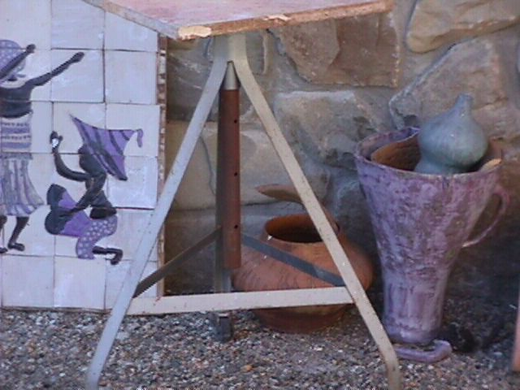
Equilateral triangle: A triangle with three congruent sides.
Notes:
equilat

Slide 17
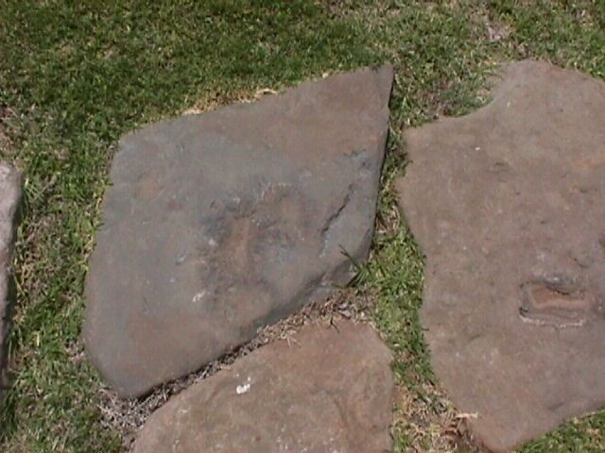
Parallelogram:
A quadrilateral whose opposite sides are parallel and congruent.
Rhombus: A parallelogram whose four sides are congruent and whose opposite angles are congruent.
Notes:
parallelogram

Slide 18
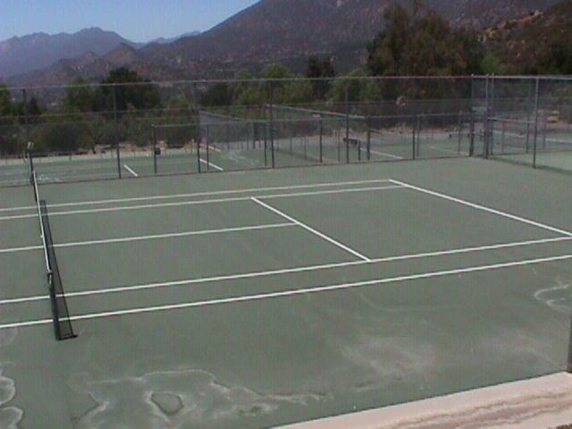
A quadrilateral whose opposite sides are parallel and congruent
Notes:
rectangle

Slide 19
triangle
Can you
Identify all
These shapes?
trapezoid
rectangle
parallelogram
Notes:
shapes

Slide 24
SOLID GEOMETRY

Slide 25
COMMON 3d Shapes

Slide 26
COMMON 3d Shapes

Slide 27
COMMON 3d Shapes

Slide 29
Are these Polyhedrons?

Slide 30
are these polyhedrons?

Slide 31
COMMON polyhedron

Slide 32
OTHER COMMON 3d Shapes

Slide 33
EXPLORE MORE!

Slide 34
Surface Areas of Right Pyramids and Right Cones
Lesson 1.4

Slide 35
Class Activity – Part 1
In a group, you are going to measure the sides using SI unit and imperial unit of the following figures:
Right Pyramid
Right Cone

Slide 36
Surface Area – is the total number of unit squares used to cover a 3-D surface.

Slide 37
Find the SA of a Rectangular Solid
A rectangular solid has 6 faces.
They are:
Front
Top
Bottom
Front
Back
Right Side
Left Side
Top
Right
Side
We can only see 3 faces at any one time.
Which of the 6 sides are the same?
Top and Bottom
Front and Back
Right Side and Left Side

Slide 38
Surface Area of a Rectangular Solid
We know that
Each face is a rectangle.
and the
Formula for finding the area of a rectangle is:
A = lw
Front
Top
Right
Side
Steps:
Find:
Area of Top
Area of Front
Area of Right Side
Find the sum of the areas
Multiply the sum by 2.
The answer you get is the surface area of the rectangular solid.

Slide 39
Example

Slide 40
Find the Surface Area of the following:
Find the Area of each face:
12 m
Top
5 m
Top
A = 12 m x 5 m = 60 m²
Right
Side
Front
8 m
Front
8 m
5 m
12 m
A = 12 m x 8 m = 96 m²
12 m
Right
Side
Sum = 60 m² + 96 m² + 40 m² = 196 m²
8 m
A = 8 m x 5 m = 40 m²
Multiply sum by 2 = 196 m² x 2 = 392 m²
The surface area = 392 m²
5 m

Slide 41
Find the Surface Area
Area of Top = 6 cm x 4 cm = 24 cm²
24 m²
Area of Front = 14 cm x 6 cm = 84 cm²
Area of Right Side = 14 cm x 4 cm = 56 cm²
Find the sum of the areas:
14 cm
84 m²
56 m²
24 cm² + 84 cm² + 56 cm² = 164 cm²
Multiply the sum by 2:
4 cm
6 cm
164 cm² x 2 = 328 cm²
The surface area of this rectangular solid is 328 cm².

Slide 42
Nets
A net is all the surfaces of a rectangular solid laid out flat.
Back
8 cm
Top
Left Side
Top
Right Side
5 cm
Right
Side
8 cm
8 cm
Front
Front
8 cm
5 cm
10 cm
Bottom
5 cm
10 cm

Slide 43
Find the Surface Area Using Nets.
Top
Back
8 cm
Right
Side
8 cm
Front
Left Side
Top
Right Side
5 cm
5 cm
8 cm
10 cm
Front
8 cm
Each surface is a rectangle.
A = lw
80
80
Bottom
5 cm
Find the area of each surface.
Which surfaces are the same?
Find the Total Surface Area.
10 cm
40
50
50
40
What is the Surface Area of the Rectangular solid?
340 cm²
Notes:
Make sure you have a sample polyhedra figure of this!

Slide 44
PYRAMID

Slide 45
COMMON polyhedron

Slide 46
SURFACE AREA

Slide 47
SURFACE AREA

Slide 48
Please refer to the textbook examples on pages 26-33.

Slide 49
Class Activity – Part 2
With the data you gathered from Part 1, calculate the following:
Surface Area

Slide 50
reflect!
1. How do you determine the surface area of a right pyramid?
2. When you see a picture of a right pyramid with a regular polygon base, how do you identify its height and its slant height?
3. How is calculating the surface area of a right pyramid like calculating the surface area of a right cone? How is it different?

Slide 51
HOMEWORK!
Answer EXERCISES # 4-21 on page 33-34.

